Slide 1

#XamExpertDay

Slide 2





Use AI In your Xamarin.Forms app to create a chatbot
Codrina Merigo
_Codrina_
Notes:
Good afternoon everyone!

Slide 3

#XamExpertDay
Notes:
First of all I want to thank our sponsors and the organizers who picked up my session.

Slide 4
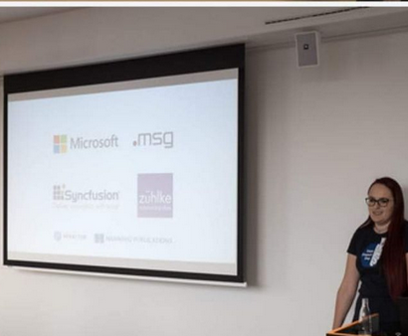

25th of October 2019
Sr Sw Eng @Fresenius Medical Care
Microsoft MVP
Agile Coach
Speaker
Mentor
Tech & Chocolate Addict
Notes:
Thankful to this conference <3
About me
Let’s get started

Slide 5
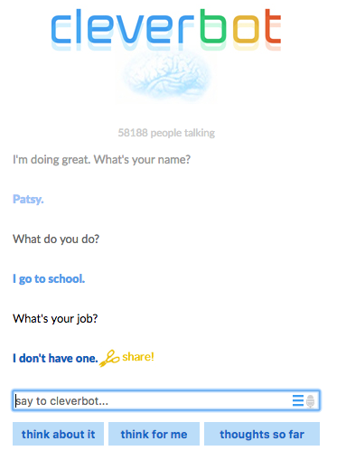
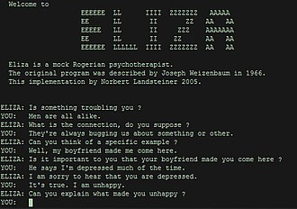
1966
Notes:
ELIZA is an early natural language processing computer program created from 1964 to 1966
Created to demonstrate the superficiality of communication between humans and machines, Eliza simulated conversation by using a 'pattern matching' and substitution methodology that gave users an illusion of understanding on the part of the program, but had no built in framework for contextualizing events.
Directives on how to interact were provided by 'scripts', written originally in MAD-Slip, which allowed ELIZA to process user inputs and engage in discourse following the rules and directions of the script. The most famous script, DOCTOR, simulated a Rogerian psychotherapist (in particular, Carl Rogers, who was well-known for simply parroting back at patients what they'd just said)and used rules, dictated in the script, to respond with non-directional questions to user inputs.
As such, ELIZA was one of the first chatterbots and one of the first programs capable of attempting the Turing Test.
Turing proposed that a human evaluator would judge natural language conversations between a human and a machine designed to generate human-like responses. The evaluator would be aware that one of the two partners in conversation is a machine, and all participants would be separated from one another. The conversation would be limited to a text-only channel such as a computer keyboard and screen so the result would not depend on the machine's ability to render words as speech. The test results do not depend on the machine's ability to give correct answers to questions, only how closely its answers resemble those a human would give.
Cleverbot was different because the user didn’t speak to a program when he enters the text. Cleverbot is based on previous conversations – it was stated that speaking with Clever bot was like speaking to the whole internet community

Slide 6
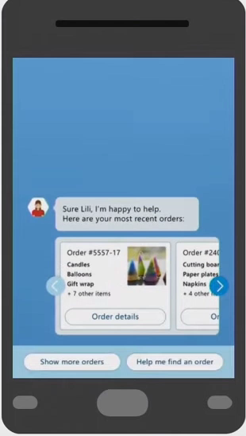
“Bots are the new applications you can converse with”
“People-to-people conversations, people-to-digital assistants,
people-to-bots and even digital assistants-to-bots.
That’s the world you’re going to get to see in the years to come.”
Satya Nadella, BUILD 2016
Notes:
Chat experience
Build, 50 years after

Slide 7




What is a bot?
Cognitive Services
...
Any API
Web app
Connectors
Channels
Users
Notes:
There are different kinds of bots, and I will focus today on chatbots, but what is exactly a bot ? Even if bots are something very generic defined as a computer program that can perform repetitive tasks, I am not referring to physical bots or robots, such as Roomba, the cleaning robot that your cat loves to go around on, but I am talking about the conversational bots. Conversational bots can also perform repetitive tasks and ideally they have a conversation with you in an humanish way.
Repetitive tasks, not for humans – creative tasks.
But you might have alexa or siri or google home , do you think they are bot ? They are more, they are digital assitants – also Cortana is one of them.

Slide 8






Conversations as a Platform
People
Digital assistants
Bots
Developers
Businesses
Communities
Notes:
Conversation as a Platform became after that a new way of thinking after introducing the language as a new ui, digital assistants as apps and intelligence was infused to all the interactions, creating a new canvas for devs, new opportunities for business and also for the communities, by introducing a new way to access, discover and interact.
Chatbots are changing online user experiences, moving users away from complex websites and apps with structured menus to a simplified command-line interface that are adjustable for everyone.

Slide 9





Benefits
Productivity task completion Enhance productivity through task automation and through automated workflows Reach customers anywhere, on any platform or device Engage with customers and users in a natural way, conversationally and in context Expose your products and services via messaging platforms, where users are already highly engaged Improve customer experience and reduce the need for human assistance
Notes:
Save on costs
Bots are principally created to do repetitive things so people and developers can do more creative tasks like creating a bot.

Slide 10
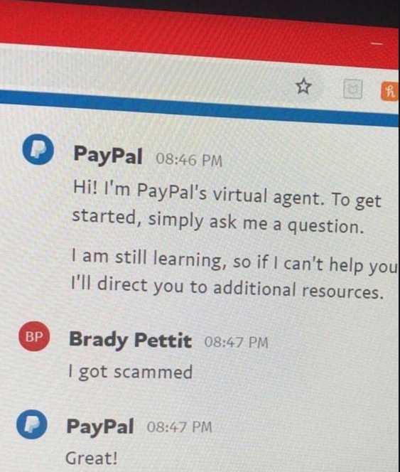
Conversational bots
Bots are apps
Bots can be found in various Channels
Bots should please with UX
Bots should be intelligent
Notes:
So as the name itself, conversational bots are bots where you have a conversation with.
Then it may pop-up a curious question, nowadays voice assistants are so popular. Most of us might have siri, google home or Alexa. Myself I have Alexa that also turned on the lights or set the temperature for me. But do you think they are bots ? They are sort of … but they are called Agents as they are the front end of a bot.
So a bot does something very concrete, so when I say ‘Alexa, buy me a train ticket to Milano’ , the actual action of buying something, that is what a bot does.
No matter how you ask it, even verbally or by typing something, you want that the bot does something for you, hopefully with a immersive user experience. Your bot app can be present in multiple channels and you expect that the bot is intelligent, but this last part is up to us, developers. You can have a very dumb bot, that answers always the same thing, but ideally you should try to make them more flexible and human-likely.

Slide 11
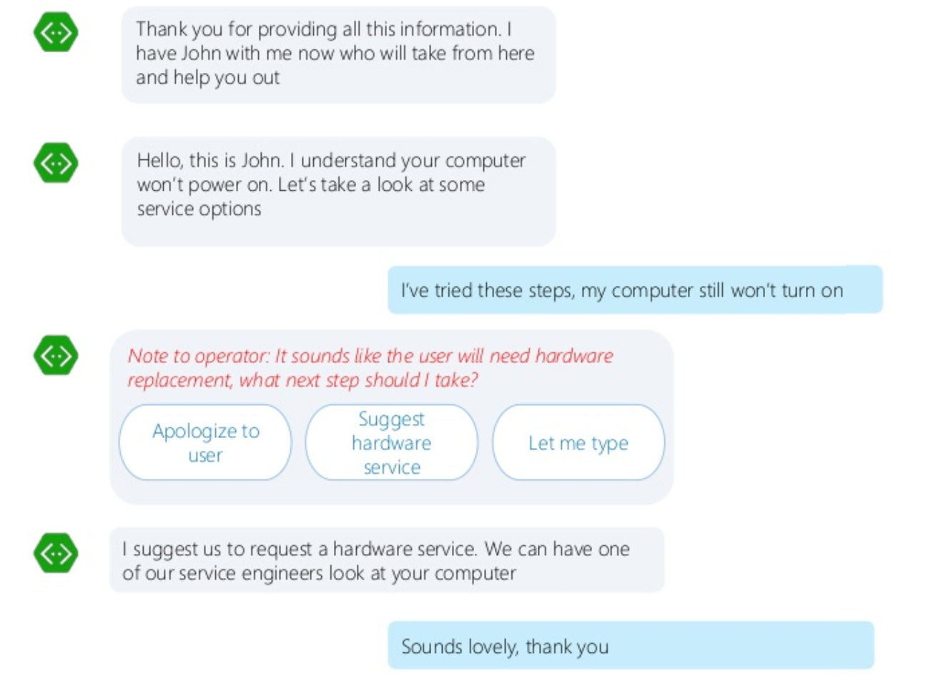
Hand-off to Human

Slide 12





Bot Frameworks
Microsoft Bot Framework
Facebook Bot Engine
Google DialogFlow
Amazon Lex
IBM Watson

Slide 13


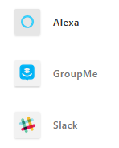
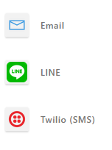
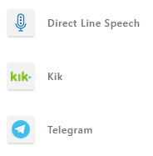
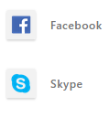

Bot Channels

Slide 14
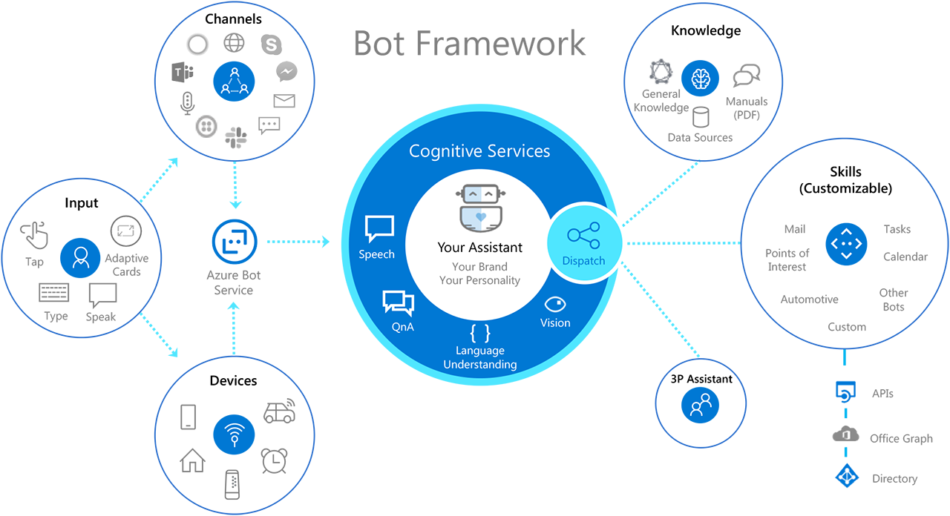
Conversational Bots Architecture – Bot Framework

Slide 15
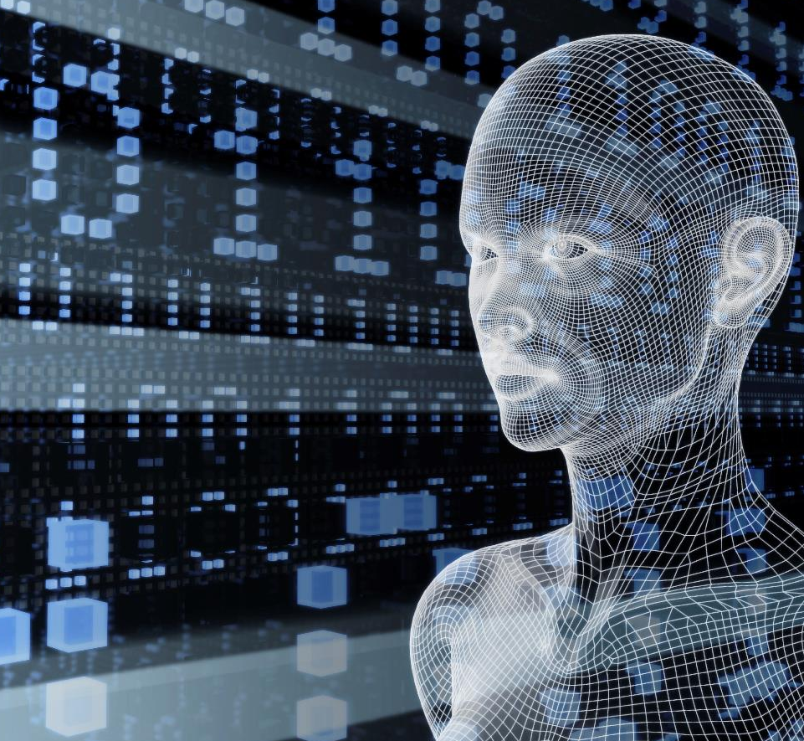
Vision
From faces to feelings, allow your apps to understand images and video
Speech
Hear and speak to your users by filtering noise, identifying speakers, and understanding intent
Microsoft Cognitive Services
Give your apps a human side
Language
Process text and learn how to recognize what users want
Web Search
Access billions of web pages, images, videos, and news with the power of Bing APIs
Decision
Build apps that surface recommendations for informed and efficient decision-making.
Notes:
Azure Cognitive Services are cloud-base services with REST APIs, and client library SDKs available to help developers build cognitive intelligence into applications without having direct artificial intelligence (AI) or data science skills or knowledge. Azure Cognitive Services enables developers to easily add cognitive features into their applications with cognitive solutions that can see, hear, speak, understand, and even begin to reason.

Slide 16
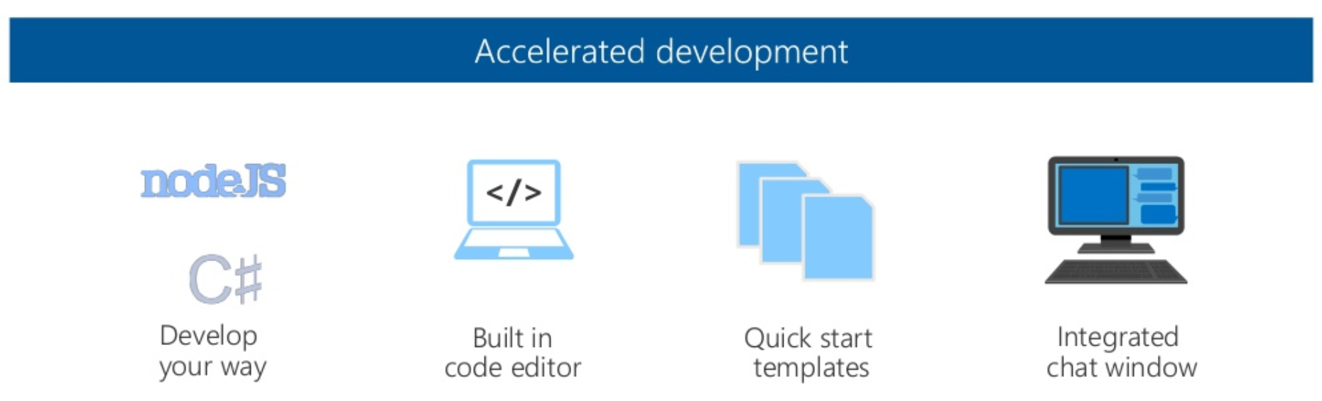
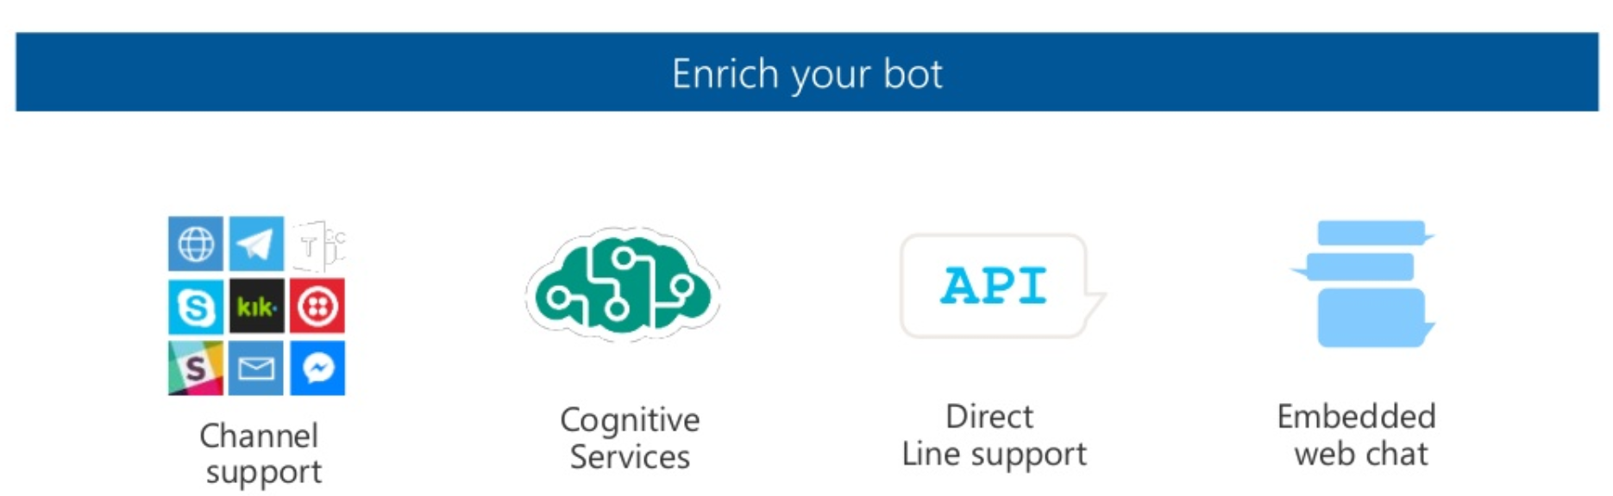
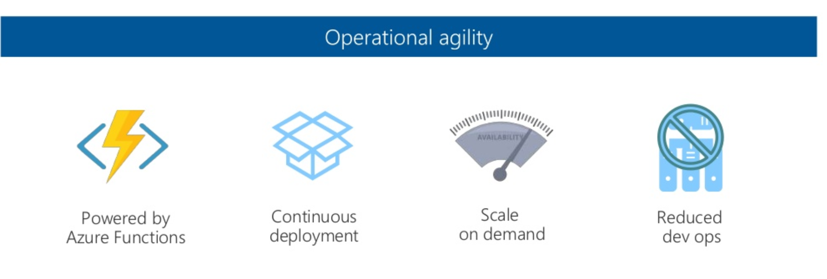
Conversational Bots Architecture – Azure Bot Service

Slide 17

DEMO
Notes:
Azure echo bot

Slide 18




Conversational Intelligence
QnA Maker
Separate information into conversational, easy-to-navigate answers
Azure search
Integrate search into a conversational experience
Language Understanding Intelligent Service
Teach your apps to understand
commands from users
BING Speech API
Separate information into conversational, easy-to-navigate answers
Speaker Recognition API
Give your app the ability to know who’s talking
Translator Easily perform speech and text translation
Custom speech service Fine-tune speech recognition for anyone, anywhere
Notes:
Regardless of the type of application you're creating (bot, website, or app), make user experience a top priority.

Slide 19
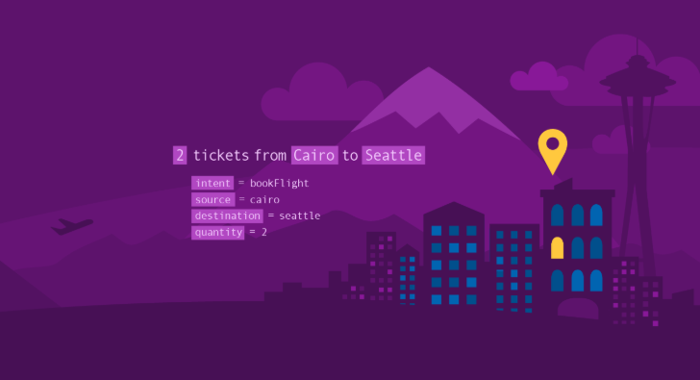
Language Understanding Intelligence Service (LUIS)
Designed to provide you with an easy way to create models, which allow your applications to understand user commands.
Notes:
Understanding language is something that even humans get wrong from time to time. Allows your application to understand what a person wants in their own words. LUIS uses machine learning to allow developers to build applications that can receive user input in natural language and extract meaning from it. For example, you might say "Book me a ticket to Paris" in which case there is the intention to "BookTicket" while “Seattle" is the destination entity.

Slide 20

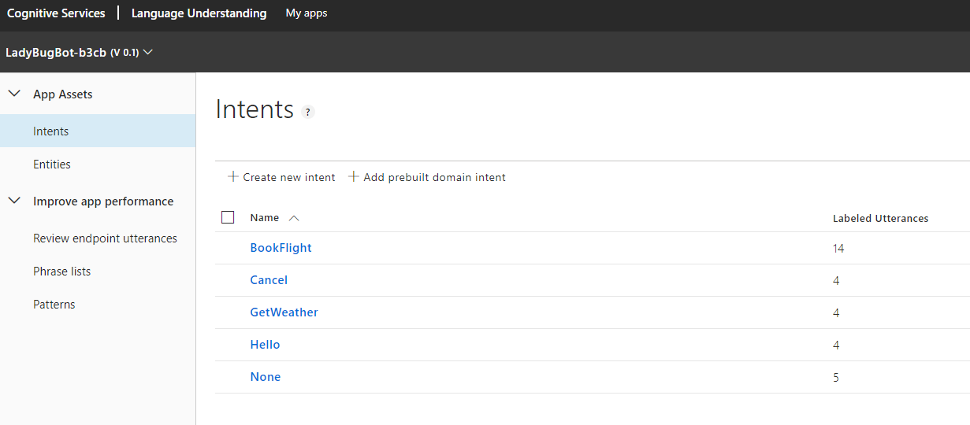
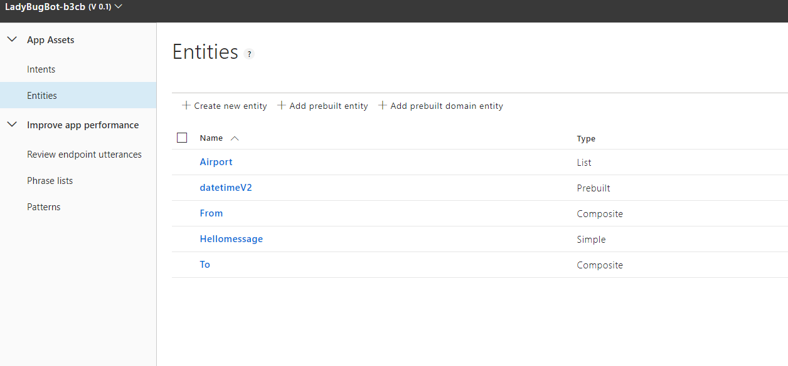
LUIS Dashboard
Notes:
LUIS makes use of three key aspects for understanding language:
Utterances: An utterance is input from the user that your app needs to interpret.
Intents: An intent represents a task or action the user wants to do. It's a purpose or goal expressed in a user's utterance.
Entities: An entity represents a word or phrase inside the utterance that you want to extract.
Intents – how LUIS determines the level of comprehension of what an user wants to execute. For example, if the clien application is a travel booking agency, it’s necessary that the intents "BuyPlaneTicket and "RentHotelRoom" are consistent in order to identify when users want to execute those different activities.
Entities
An entity is used as a variable, that will pass the relevant information for the client application.
During the training, LUIS will learn which types of imput are needed to be associated according to the different entities. Each time you add a new set of edits to your LUIS app, it will be necessary to execute the training to that the app will use the new data.

Slide 21
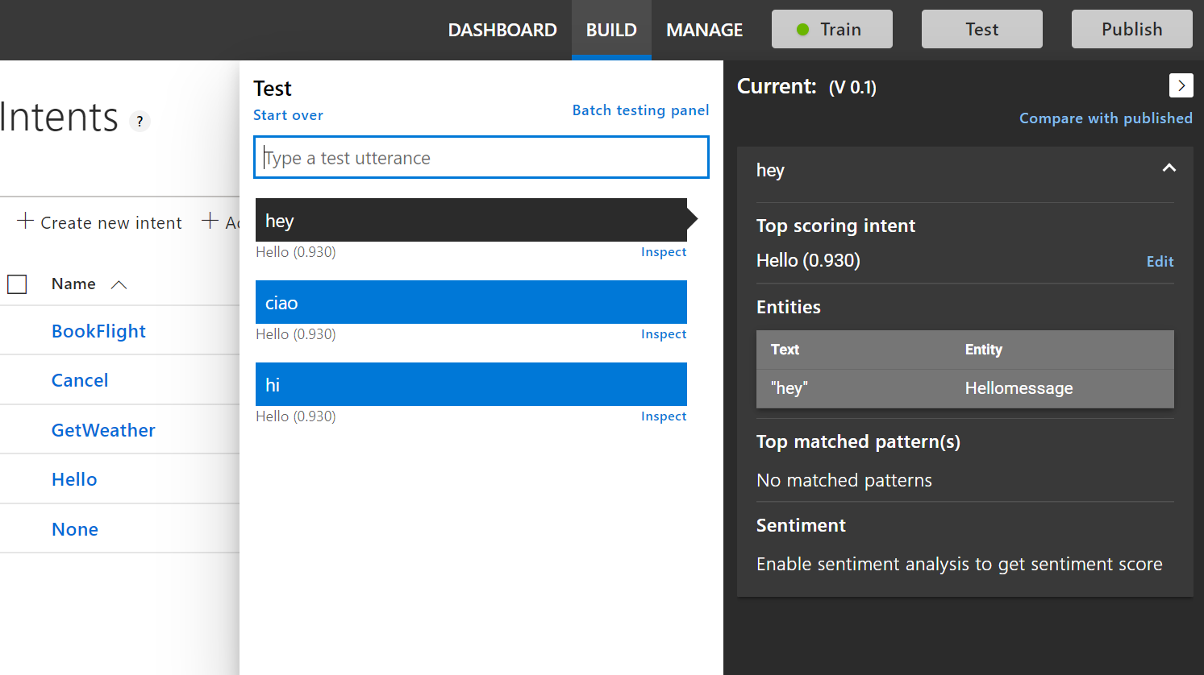
LUIS Dashboard - Testing
Notes:
After completing the training for the LUIS app, you will be able to test it directly from the LUIS dashborard and LUIS will give back an intent score.

Slide 22
Language Understanding Models
{
“entities”: [
{
“entity”: “flight_delays”,
“type”: “Topic”
}
],
“intents”: [
{
“intent”: “FindNews”,
“score”: 0.99853384
},
{
“intent”: “None”,
“score”: 0.07289317
},
{
“intent”: “ReadNews”,
“score”: 0.0167122427
},
{
“intent”: “ShareNews”,
“score”: 1.0919299E-06
}
]
}
“News about flight delays”

Slide 23
DEMO
Notes:
Our next step for the PictureBotLUIS app is creating intents that map to user requests. We want our picture-management bot to understand how to:
Find pictures.
Share pictures on social media.
Order prints of pictures.
Greet the user.

Slide 24
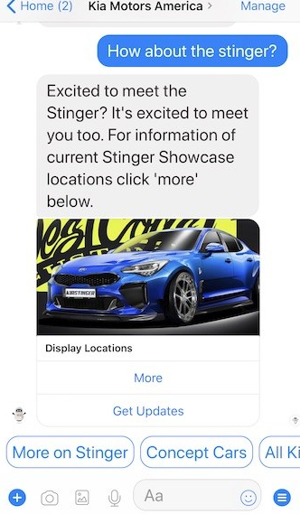
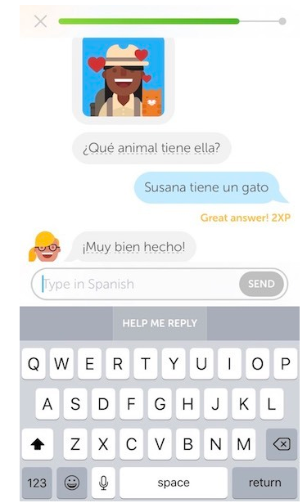
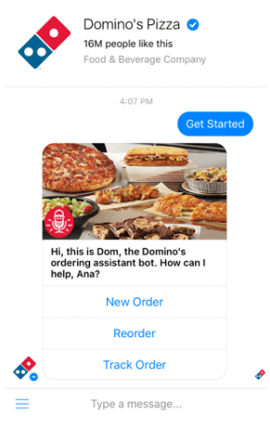
Conversational Pieces
Notes:
Text Messages
Media in Messages
Buttons
Prompts - no need for user entry
Cards
Dialogs

Slide 25

DEMO

Slide 26
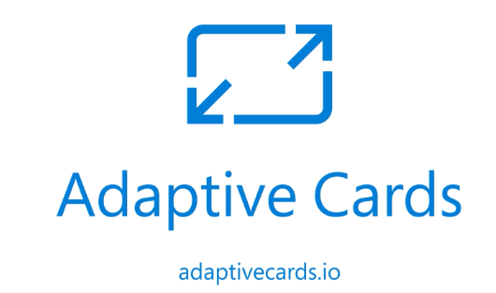
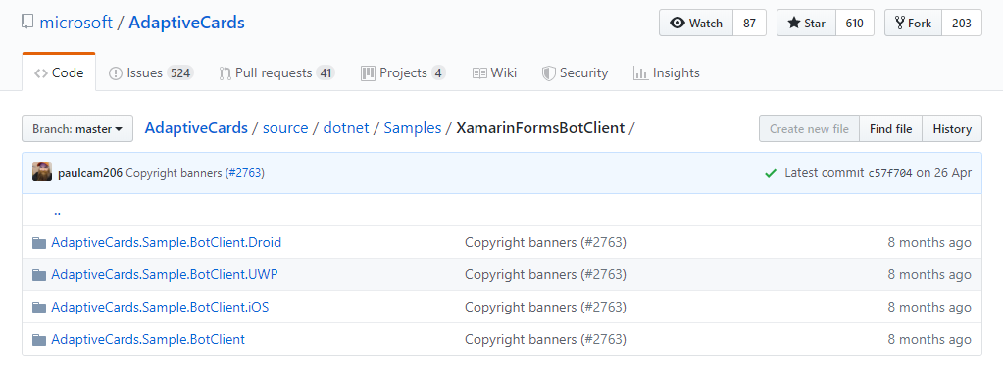
Adaptative Cards
WPF Cards
Custom renderers
Notes:
Adaptive Cards are an open card exchange format enabling developers to exchange UI content in a common and consistent way.

Slide 27
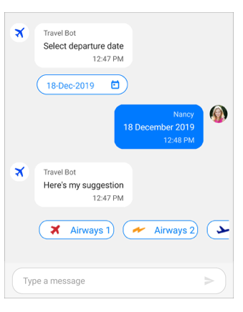
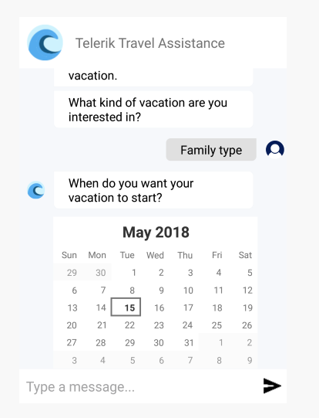
Third party libraries components
Syncfusion
Xamarin.Forms Chat
Telerik
Conversational UI
Notes:
Adaptive Cards are an open card exchange format enabling developers to exchange UI content in a common and consistent way.

Slide 28
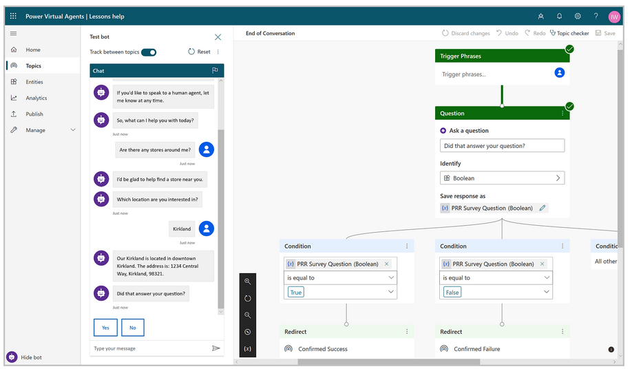
Ignite 2020 announcement – Power Virtual Agents
Using Power Virtual Agents, you are in the driver's seat. Your SMEs can create bots quickly and easily using a
novel, intuitive, code-free graphical interface, eliminating the need for AI expertise or teams of developers.

Slide 29
Q & A

Slide 30
Thank You!
_Codrina_

